Slide 1


A Seminar Review on
SYSTEM SURVEILLANCE USING KEYLOGGER
Presented by
Rohit Gaware ( Roll. 30 )
&
Rohan Hardade ( Roll. 29 )
PCET’S Nutan College of Engineering and Research ( NCER )
Department of CSE – AI
2022 - 23
1

Slide 2
AGENDA OF PRESENTATION
Title Page
Title of Project
Introduction
What is Keylogger?
Objective
Type of Keylogger
Tools and Platform
Software and Hardware Requirements
Use case Diagram
Code Implimentation
Future Scope
Reference

Slide 3
TITLE OF PROJECT
SYSTEM SURVEILLANCE USING KEYLOGGER

Slide 4
INTRODUCTION
In many IT infrastructure organizations now-a-day, data security and data recovery is now the most important factor. In many cases where data recovery is required. For these kinds of problems, a keylogger is one of the best solutions, which is often referred to as keylogging or keyboard capture.
Keycrapping is the act or recordings keystrokes on a keyboard, usually covertly so that the person using the keyboard does not know that their actions are being monitored. This is tracking application used to track the users which records the keystrokes; using log files to retrieve information.
Using this application, we can recall a forgotten email or URL. In this keylogger project, whenever the user types something on a keyboard, the keystrokes are captured and send to the admins email.

Slide 5
WHAT IS A KEYLOGGER?
A keylogger is an invisible tool for surveillance that allow you to monitor the activities carried out by the users of your computer without them knowing.
A keylogger is great for both companies who want to keep track of their employee’s internet and computer usage or for private persons where the family shares one or many computers.
This great product is not always used for surveillance, it can also be a great tool for the person with many passwords and user names to easier remember them.

Slide 6
OBJECTIVE
Develop a keystroke logging software to accurately and discreetly record all keystrokes made on a target system.
Capture keystrokes in real-time, including letters, numbers, special characters, and function keys.
Implement a secure storage mechanism to store the recorded keystrokes, ensuring data confidentiality and integrity.
Create a user-friendly interface to view and manage the recorded keystrokes effectively.
Explore the possibility of capturing keystrokes from multiple input sources, including physical keyboards, virtual keyboards, and on-screen keyboards

Slide 7
Types of keylogger
There are Two types of Keylogger :
1) Software key-loggers
2) Hardware Key-loggers
Software key-loggers : Software key-loggers are the computer programs which are developed to steal password from the victims computer. However key loggers are used in IT organizations to troubleshoot technical problems with computers and business networks.
Hardware Key-loggers : These are not dependent on any software as these are hardware key-loggers. keyboard hardware is a circuit which is attached in a keyboard itself that whenever the key of that keyboard pressed it gets recorded.

Slide 8
TOOLS AND PLATFORM
The technology selected for implementing the System Surveillance using Keylogger is Python Programing Language and Python Libraries.
The development was done in ‘Windows’ environment for developing this project use Visual Studio Code tool.

Slide 9
Hardware & Software Requirements
It needs Most recent version of Visual Studio Code
Hardware Requirement :
CPU : Single Core 2.4 GHZ
RAM : 512 MB (Min)
Graphics Card : Intel
Hard Drive : 5 GB (Min)
Operating Systems : Windows(7,8,10,11) Mac OS, Linux
Internet Connection with good speed.

Slide 10
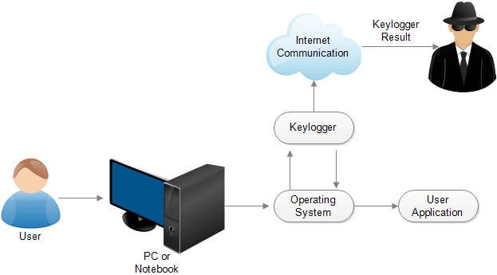
USE CASE DIAGRAM

Slide 11
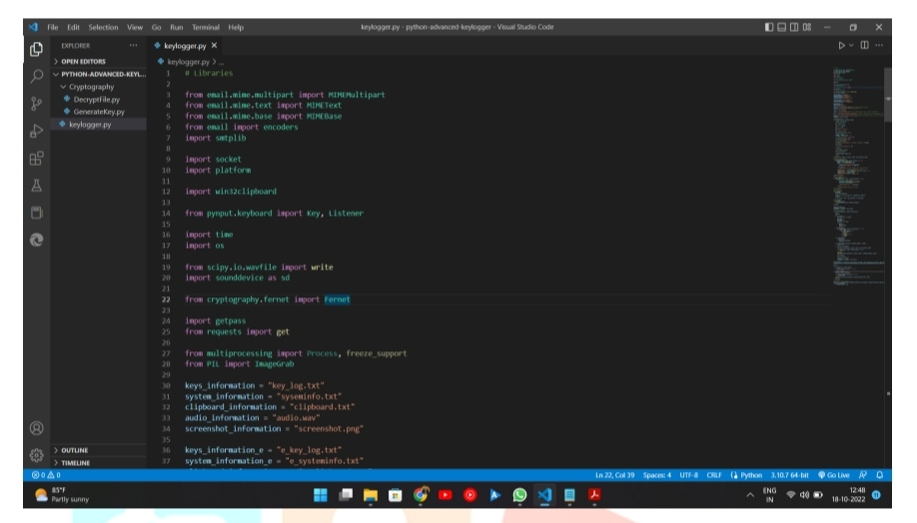
CODE IMPLIMENTATION

Slide 12
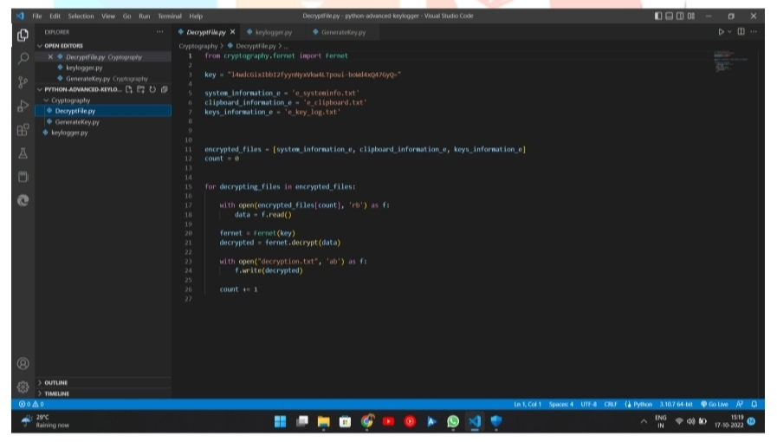
CODE IMPLIMENTATION

Slide 13
Conclusion
A Keylogger is a form of software which is used to track or log the all the keys that a user strikes on their keyboard, usually in secret so that the user of the system doesn’t know that their actions are being monitored.
It is otherwise known as keyboard capturer. These are perfectly legal and useful. They can be installed by employers to oversee the use of their computers, meaning that the employees have to complete their tasks instead of procrastinating on social media.

Slide 14
Reference
● Santripti Bhujel | Mrs. N. Priya,”Keylogger for Windows using Python” https://www.ijtsrd.com/computerscience/other/37991/keylogger-for-windows-using-python/santripti-bhujel ● Kavya .C, Suganya.R, “SURVEY ON KEYSTROKE LOGGING ATTACKS” https://www.ijcrt.org/papers/IJCRT2104074.pdf
● Devashree Kataria , Manan Kalpesh Shah , S Bharath Raj , Priya G, “Real Time Working of Keylogger Malware Analysis” https://www.ijert.org/real-time-working-of-keylogger-malware-analysis
● Disha H. Parekh, Nehal Adhvaryu, Vishal Dahiya,”Keystroke Logging: Integrating Natural Language Processing Technique to Analyze Log Data” https://www.ijitee.org/wp-content/uploads/papers/v9i3/C8817019320.pdf
● Jia Wang, Brent Lagesse, “KeyGuard: Using Selective Encryption to Mitigate Keylogging in Third-Party IME ”https://arxiv.org/pdf/2011.10012.pdf

Slide 15
THANK YOU
15

